Slide 1


Numerical Dataset
Vehicle dataset

Slide 2
About Dataset
Number of Rows:
4341 row
Number of samples:
Trian : 1612
Validation : 404
Test : 404

Slide 3
About Dataset
Data Preprocessing:
Cleaning Data: Used get dummies on ocean proximity column because it contains string values so it converts string value into columns each column contains value (0, 1)
Standard Scaler: by making preprocessor function it’s parameter is x metrices of matrix to make values of each feature column(from column 0 to column 7) scale the data by normalization and transform it under the bell curve(0~1)

Slide 4
Code Details
feature extraction :
Number of Columns : 8
Features names : we used all the columns except the name
The Dimension of resulted features: (4341 ,7)

Slide 5
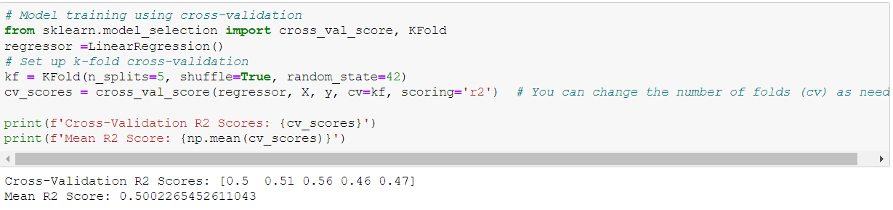
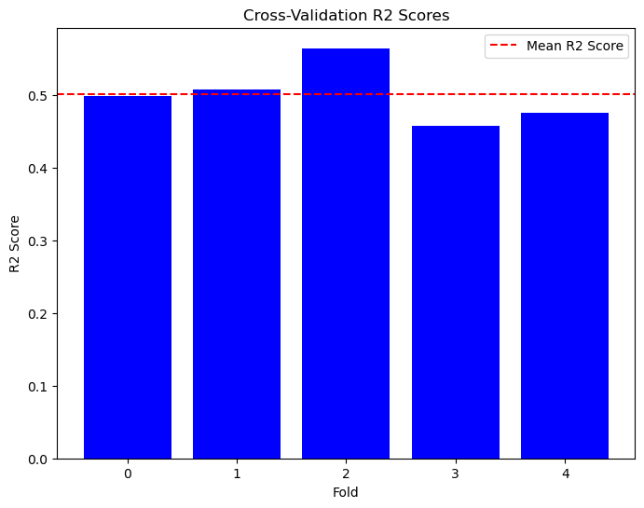
Code Details
Cross-validation:
Number of fold : 5
Number of Training : 1612
Number of Testing : 404

Slide 6
Code Details
Hyperparameter :
KNN : K = 5 (K is the hyperparameter)

Slide 7
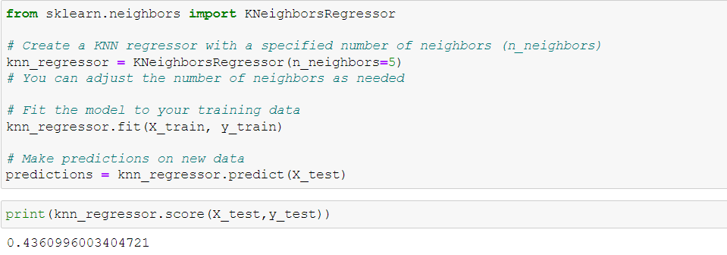
Code Details
Hyperparameter Tuning :

Slide 8
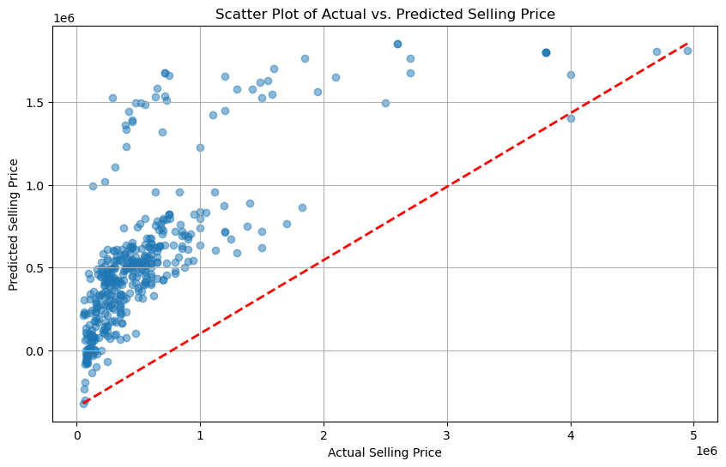
Result Details
Linear regression :

Slide 9
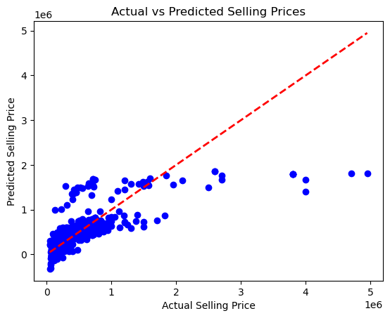
Result Details
KNN :

Slide 10
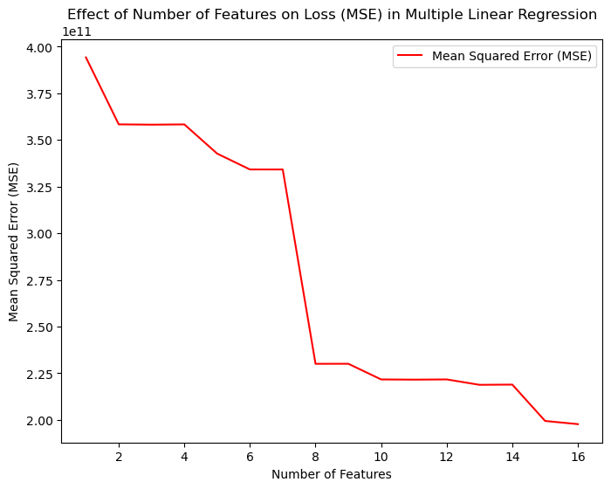
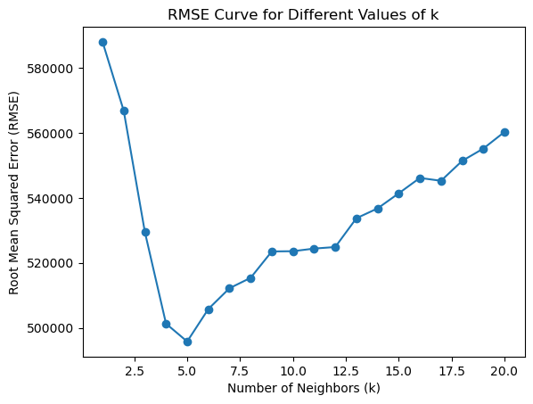
Result Details
Mean Squared Error
Root Mean Squared Error

Slide 11
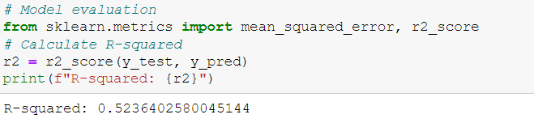
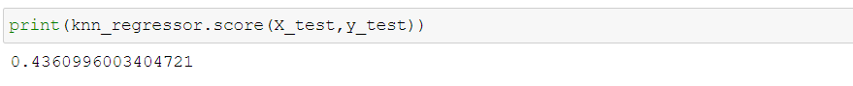
Result Details
Final Accuracy
Linear regression
KNN

Slide 12
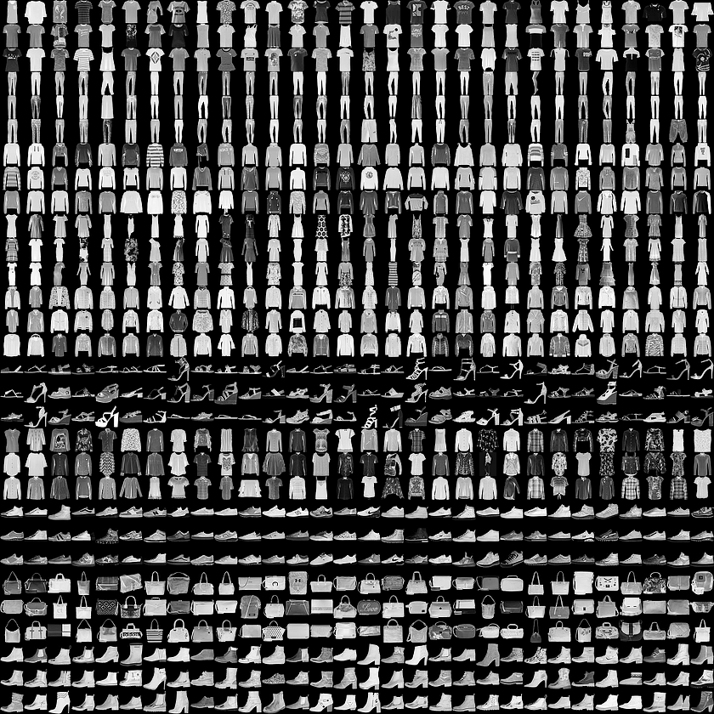
Image Dataset
fashion-mnist dataset

Slide 13
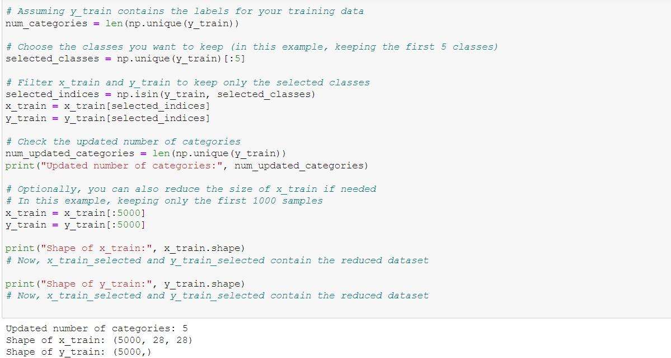
About Dataset
Number of classes : 5
Labels :
T-shirt/top
Trouser
Pullover
Dress
Coat

Slide 14
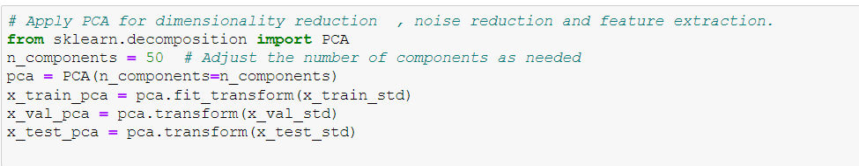
Code Details
feature extraction :

Slide 15
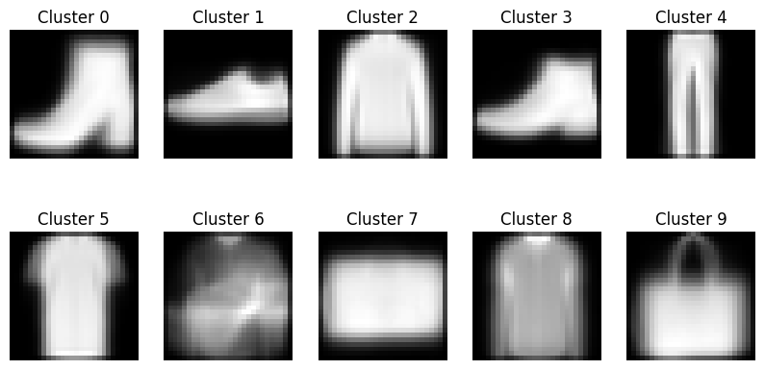
Code Details
Hyperparameter(K_Mean): 9 clusters

Slide 16
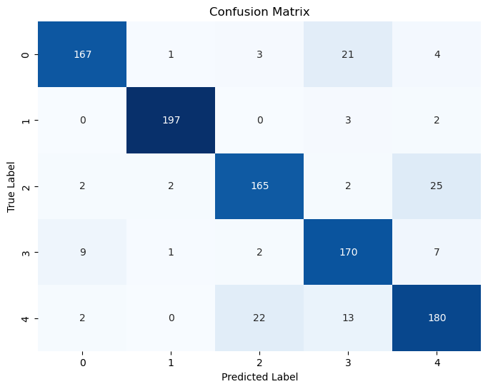
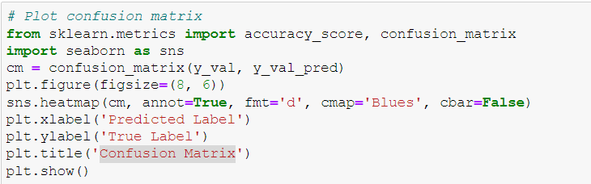
Code Details
Confusion Matrix:

Slide 17
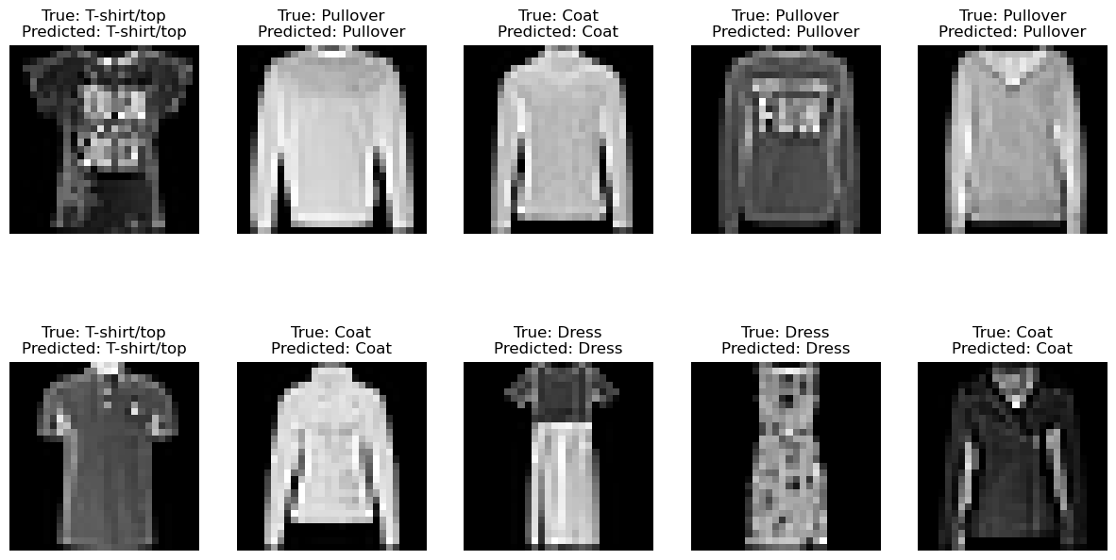
Result Details
Some correctly predicted (Logistic regression):

Slide 18
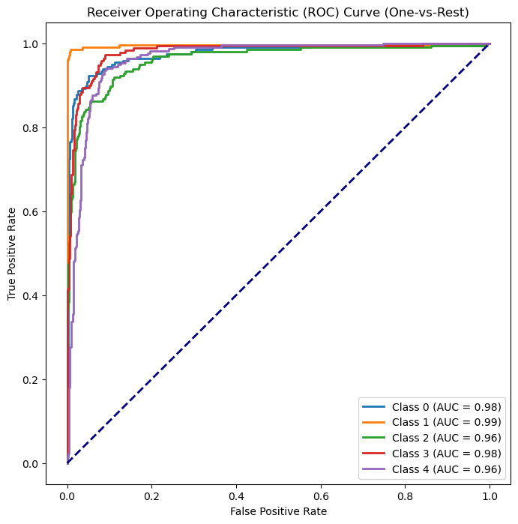
Result Details
ROC curve :

Slide 19
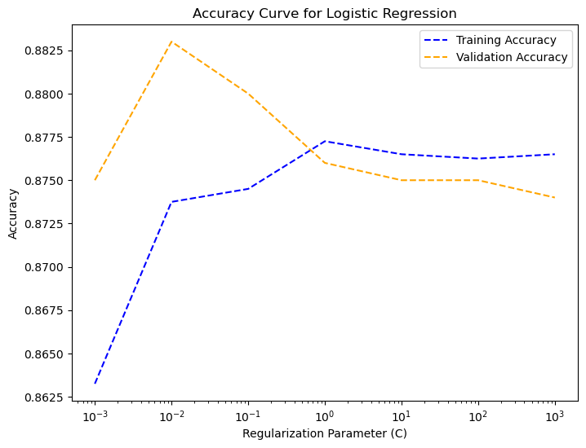
Result Details
Accuracy Curve for Logistic Regression:

Slide 20
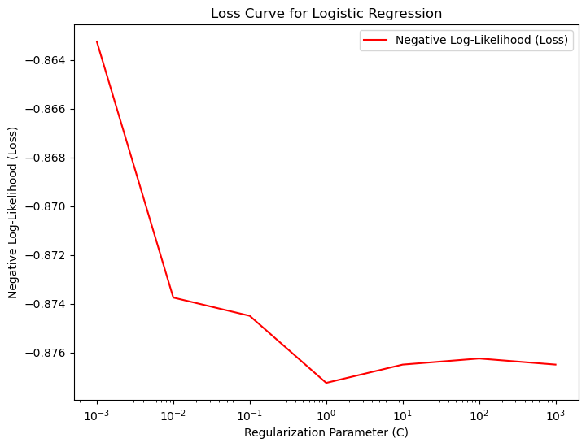
Result Details
Loss Curve:

Slide 21
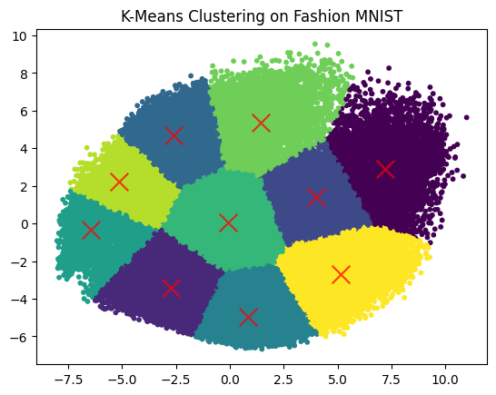
Result Details
K-Means Clustering :

Slide 22
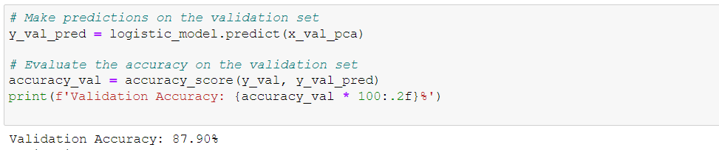
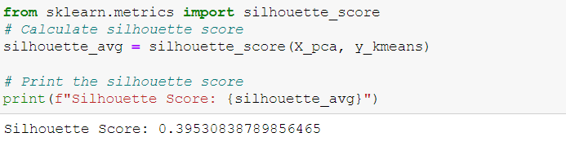
Result Details
Final Accuracy
Logistic regression
K-Mean

Slide 23


